Slide 1


A order management system realized with Progressive Web Apps(PWA)
HOCHSCHULE FÜR TECHNIK UND WIRTSCHAFT DRESDEN (FH) Fakultät Informatik/Mathematik
ZHEJIANG UNIVERSITY OF SCIENCE AND TECHNOLOGY(ZUST)
Information and Computing Science
WangCan &LuoRunyi

Slide 2

CONTENTS
01
02
03
SOMETHING WE CHANGED
SOMETHING ALREADY REALIZED
THESIS TOPIC

Slide 3
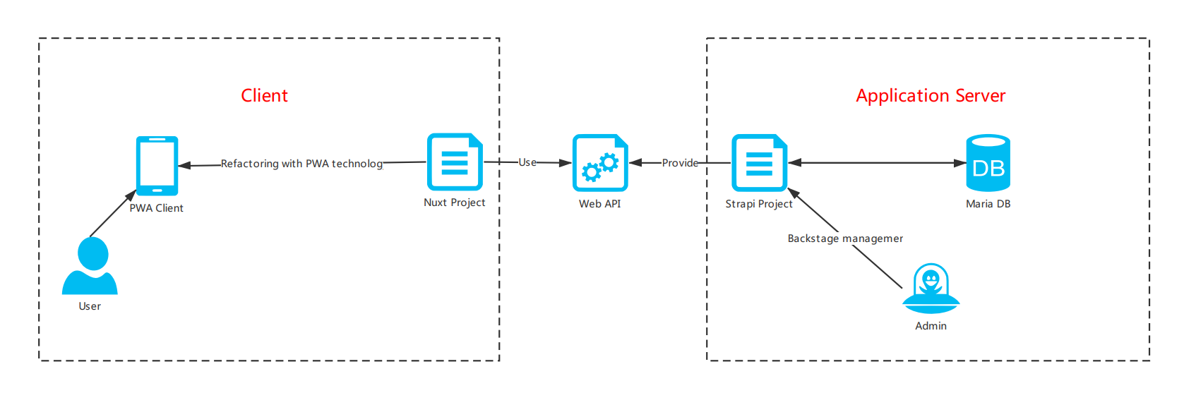
01
SOMETHING WE CHANGED
Change the main struct

Slide 4
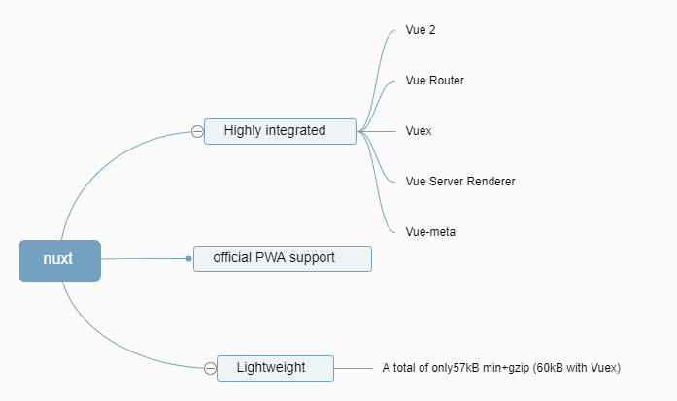
01
SOMETHING WE CHANGED
What is Nuxt.js?
Why is Nuxt.js?
Nuxt.js is a framework for creating Vue.js applications.
Its main scope is UI rendering while abstracting away the client/server distribution.
see Nuxt project struct & life cycle on next page

Slide 5
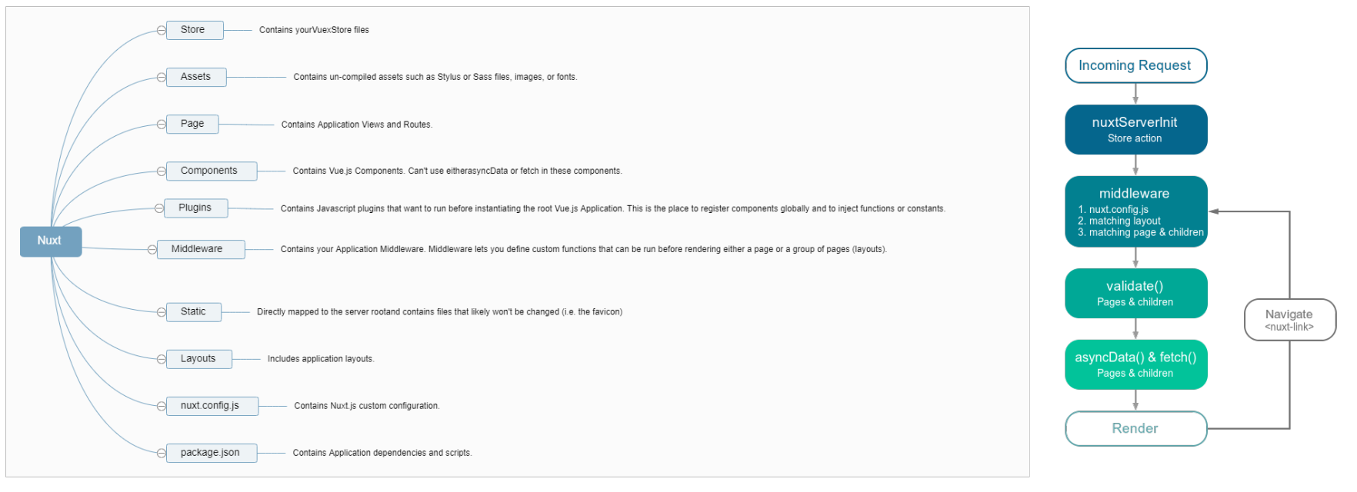
01
SOMETHING WE CHANGED

Slide 6
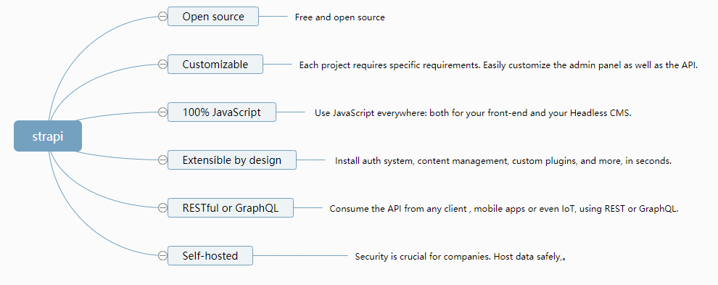
01
SOMETHING WE CHANGED
What/why is strapi ?
Strapi - Open source Node.js Headless CMS

Slide 7
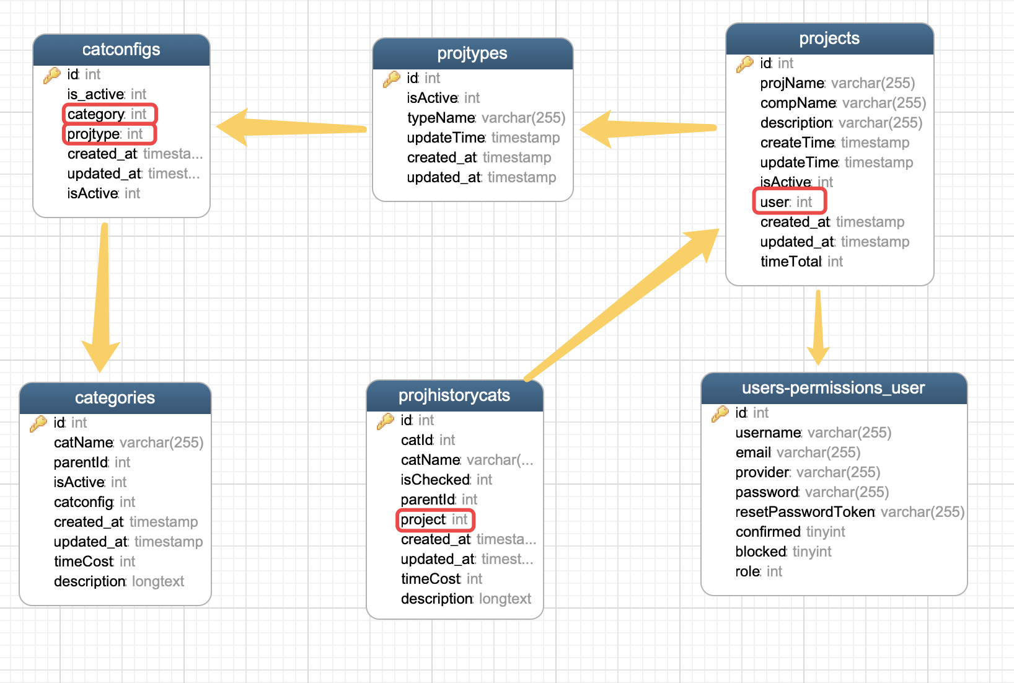
01
SOMETHING WE CHANGED
Change the database struct
No.1 yomusers=> users
strapi provide useful user API.
No.2 add some Attributes

Slide 8

02
SOMETHING ALREADY REALIZED
The main function:
create a New project
search projects
auth external API (JWT)
preview
YOM
All the static page & Page logic

Slide 9
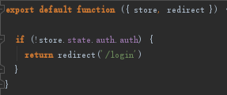
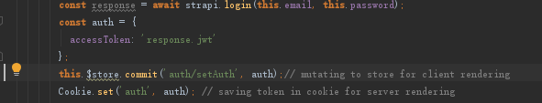
02
SOMETHING ALREADY REALIZED
middeware/
authenticated.js
Auth Routes(Using JWT & middleware)
strapi provide useful user API.One of them is login return Userinfo & JWT(JSON Web Token) for auth.

Slide 10
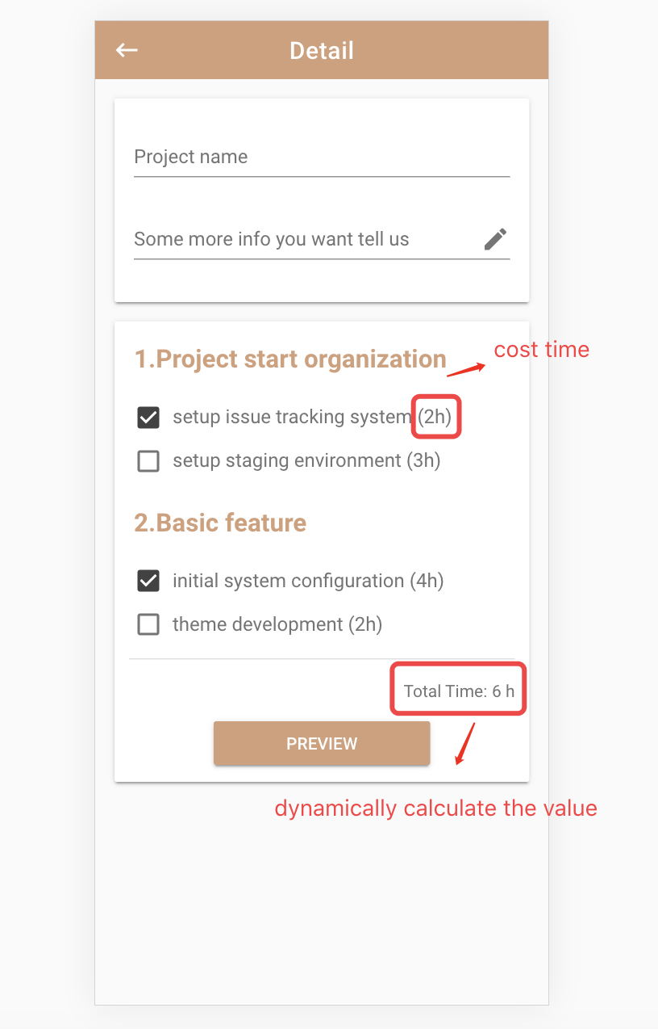
02
SOMETHING ALREADY REALIZED
Detail Page
When you check the item, the value of “Total Time” will dynamically be calculated.

Slide 11
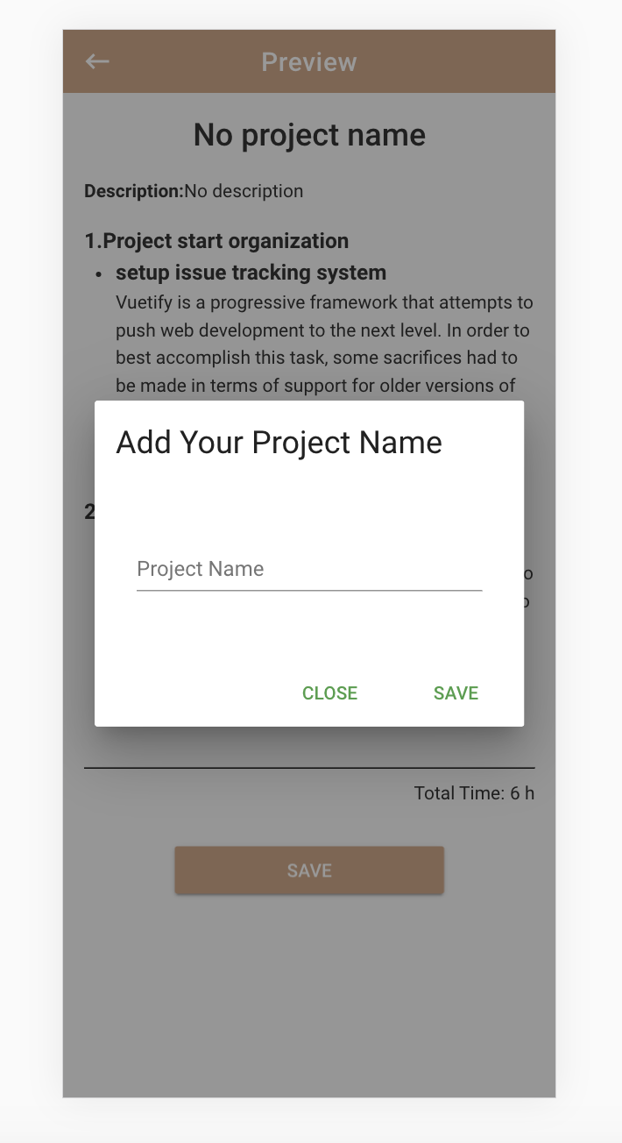
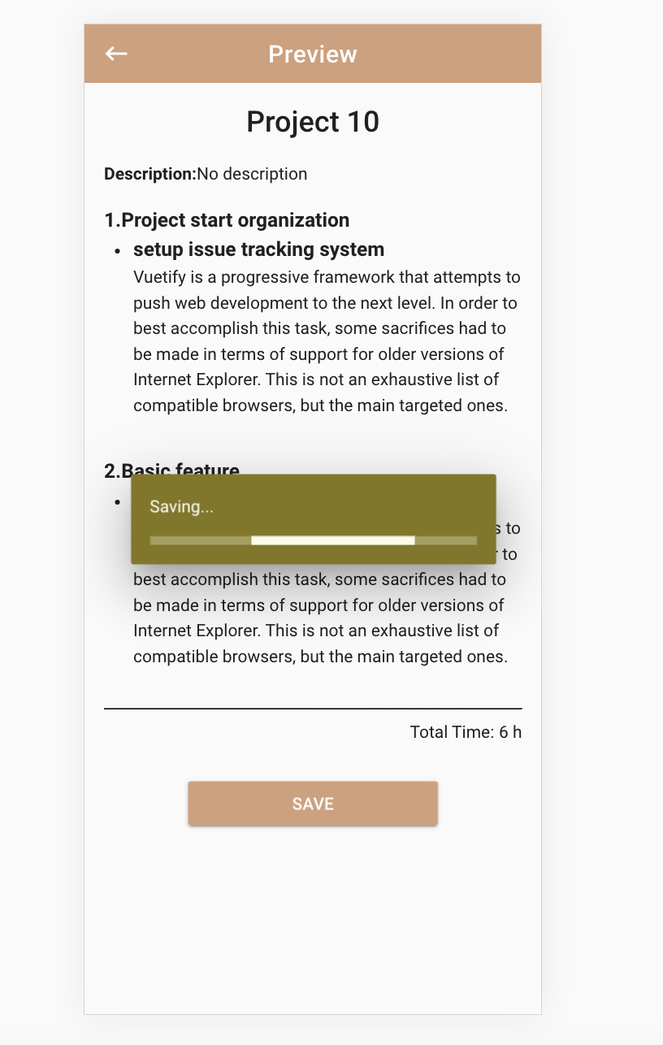
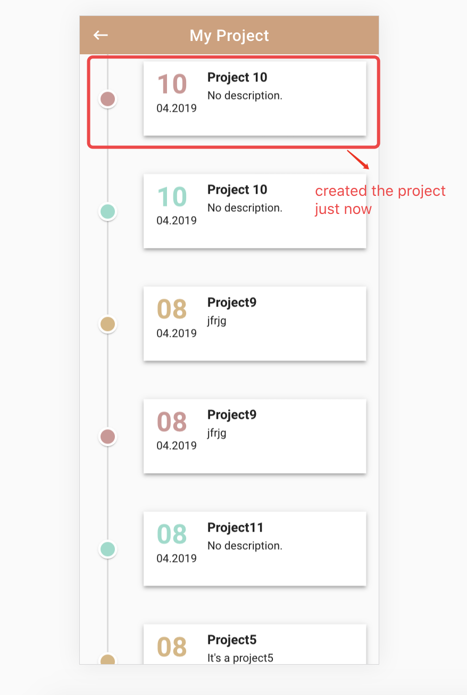
02
SOMETHING ALREADY REALIZED
Preview Page
1.If user doesn’t add “project name” at the detail page, user has to add it while saving the project
2.Click “save” => The dialog “Add Your Project Name” shows => Save data successfully => Go to “project page”
3.User also can go back to “Detail Page” to add the project name or edit the checked items.

Slide 12
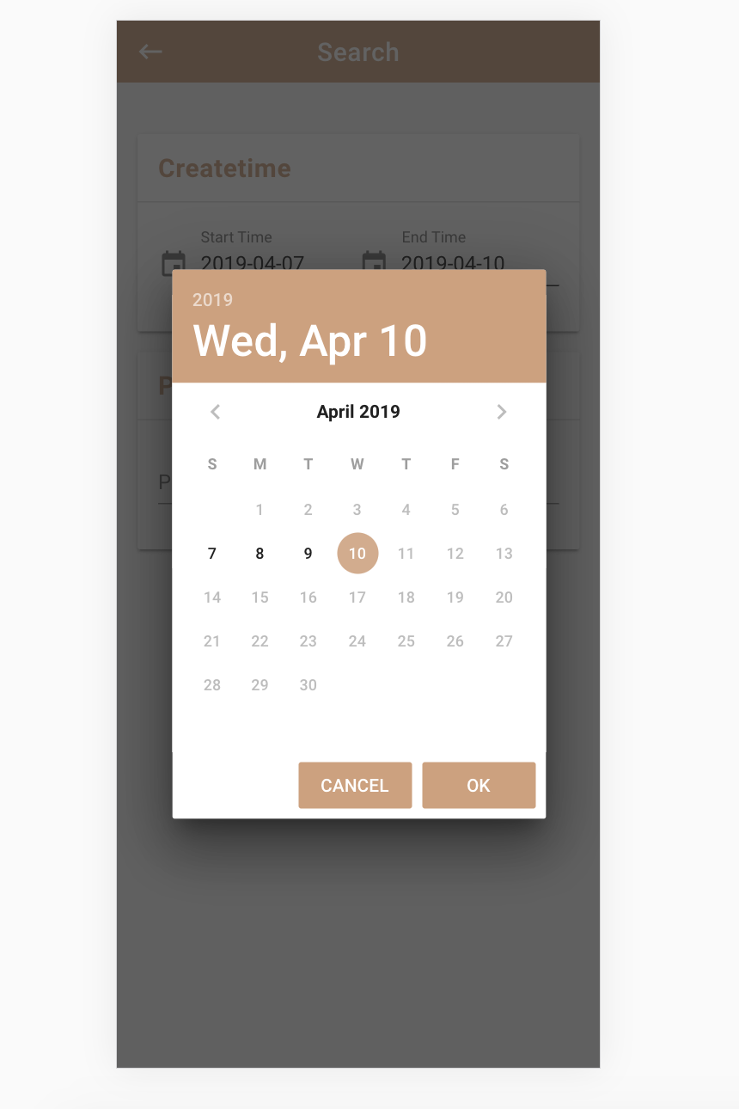
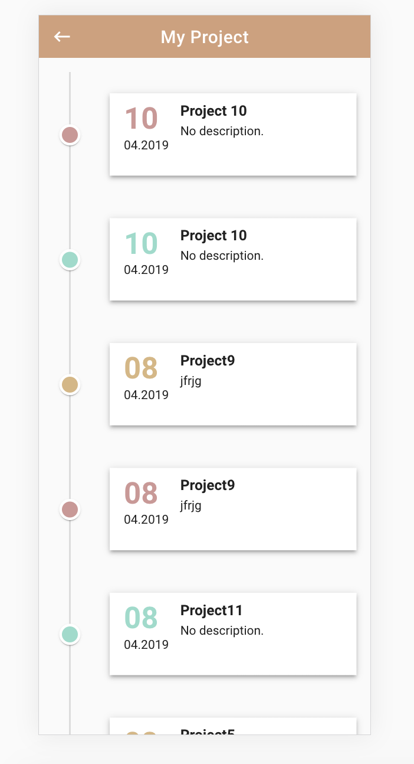
02
SOMETHING ALREADY REALIZED
Search Page & Project Page
1.End time is between start time and the today’s date.
2. Click “SEARCH” => “Project Page” shows the first 10 datas => Pull down the page=> Another 10 datas loaded

Slide 13
03
THESIS TOPIC
A nuxt&strapi infrastructure for an order management system for a PWA client(Wang Can)
A nuxt-pwa client for order management system with offline capability(Luo Runyi)

